Slide 1
Media Size
The current PWG defined media sizes cannot cover not only Canon printer’s support papers but also other vendors’. In order to improve driver-less printing environment we would like to request to define the following paper sizes:
[Cut Paper]
A2+
Architectural Paper Sizes: Arch E2, Arch E3
Photographic Paper Sizes: 20R(大全), 18”x22”(全紙), 14”x17”(半切), 12”x16”(小半切), 10R(四切) , S10R(四切ワイド)

Slide 2
Name | Name (Japanese) | mm | in | Reference
A2+ | A2ノビ | 431.8 x 609.6 mm | 17 x 24 in | -
Arch E2 | - | - | 26 x 38 in | -
Arch E3 | - | - | 27 x 39 in | -
20R | 大全 | 508 x 610 mm | 20 x 24 in | ISO 1008
18”x22” | 全紙 | 457 x 560 mm | 18 x 22 in | JIS K 7523
14”x17” | 半切 | 356 x 432 mm | 14 x 17 in | JIS K 7523
12”x16” | 小半切 | 305 x 406 mm | 12 x 16 in | ISO 1008
10R | 四切 | 254 x 305 mm | 10 x 12 in | ISO 1008
S10R | 四切ワイド | 254 x 381 mm | 10 x 15 in | -

Slide 3
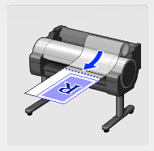
Roll Paper Cut Line Print

Slide 4
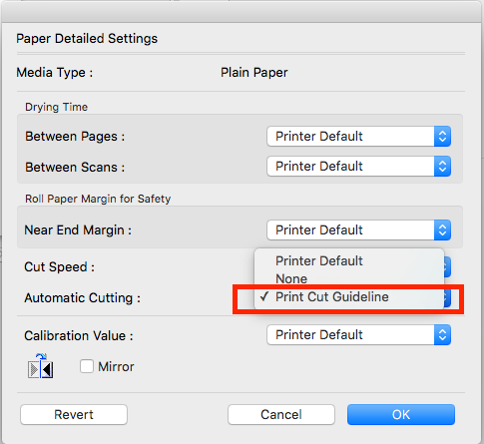
Roll Paper Cut Line Print

Slide 5
Roll Paper Cut Line Print
Description
To print with a paper cut line between pages when printing on a roll paper without cutting.
Background
Other printer vendors also support this feature, since customers of Large Format Printer strongly demand this feature implementation.
Purpose
Cutting all pages after finishing printing for a whole roll paper is one of LFP’s business use case. To provide a feature for this use case.
It is necessary especially when printing on a specific print media, e.g. Flame-Resistant Cloth, which cannot be cut by a paper cutter equipped with a printer.
Request
Defining a new trimming-type value, e.g. “draw-line”, on ipp-finishings.

