Slide 1
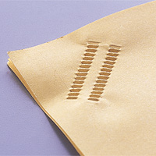
1.Eco Staple
Function/Purpose
Provides the eco-staple function which binds paper together without using metal staples.
Used in more and more offices as a eco-friendly and resource saving alternative to using conventional staples.
More vendors are supporting both conventional stapler and eco-stapler with their products.
We would like to request addition of eco-staple definitions.

Slide 2
1.Eco Staple
Proposal
Add definition of eco-staple in "finishings”
eco-staple-top-left, eco-staple-top-right
eco-staple-bottom-left, eco-staple-bottom-right
eco‐staple-dual-top, eco-staple-dual-bottom
eco-staple-dual-left, eco-staple-dual-right

