Slide 1
Canon IPP Feature Proposals
April 6, 2016

Slide 2
Contents
multi-punch with punching-number
password for account-id

Slide 3
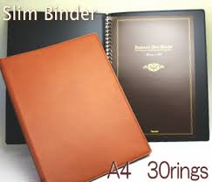
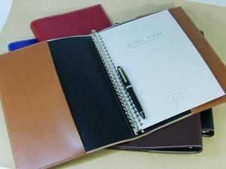
multi-punch & punching-number
The following are IPP finishings enum values defined for punch
Position and number of punches up two four
‘punch-dual-left’, ….‘punch-triple-left’, ….‘punch-quad-bottom’
Issue
Lacking definition for multiple hole punching.
e.g. 30 rings, 26 rings, etc.
Proposal
Instead of defining all possible number of punches, we request to add these ‘multi-hole’ finishings enum values.
‘punch-multi-hole-left’
‘punch-multi-hole-top’
‘punch-multi-hole-right’
‘punch-multi-hole-bottom’
In addition, define ’punching-number’ attribute (integer) as a member of “finishings-col/punching”.
When a client specifies ‘punch-multi-hole-XX’ in a finishing-template, the client, at the same time, needs to specify the number of punch holes as “punching-number” (for example, “26”).
B5 26rings

Slide 4
password for account-id
Issue
The following are defined in PWG 5100.3 as attributes to associate print jobs with department account ID
job-account-id
job-account-id-default
job-account-id-supported
However, account-id itself is not confidential information. Therefore, any user who knows the account-id of other departments can print out documents by specifying those account ids.
Proposal
For security enhancement, define attributes to specify a password for using account-id.
job-account-password
job-account-password-supported（boolean）
job-account-password-repertoire-supported (1setOf (type2 keyword))
For printers with “job-account-password-supported” set to true, allow clients to set a password for their job-account-id to print out documents. Note that it is implementation dependent as to how the printer is configured with account IDs and account passwords.

