Slide 1
Expected new IPP flow
Eliminate Upper and Lower Margins
Canon Inc.

Slide 2
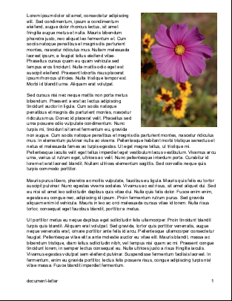
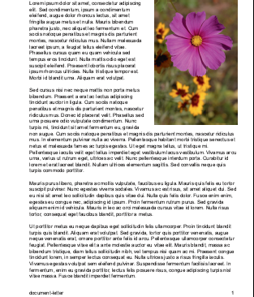
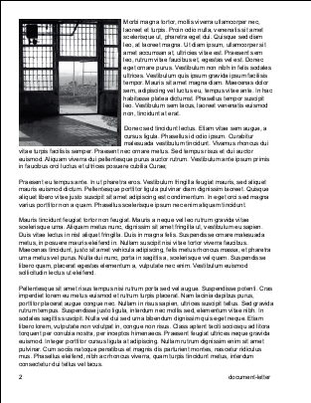
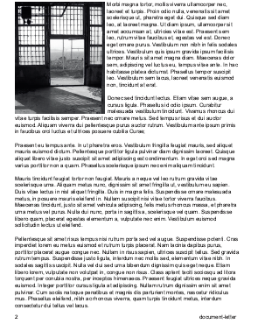
What “eliminate-margin” feature does?
“Eliminate Upper and Lower Margins” is to eliminate
role paper wasting. Client sends the command for job unit,
and the printer controls the paper feed in that manner
(to eliminate the white margins) for every page in the job.
Eliminate margins
Roll paper cut maybe controlled separately by another
IPP Attribute, likely finishing-col.
Similarly to Eliminate margins, the paper cut is performed
for every page once finishing-col is issued at the
beginning of the job. See the page 4.
Original
Document
Printed
pages

Slide 3
How it determines the margin to eliminate?
(In other words, how the printer controls paper feed.)
①
Stop paper feed for the white lines length which is specified by IPP standard protocol as Top margin.
(The length is notified from the printer by standard IPP protocol in advance.)
②
Stop paper feed for the following white lines until any non-white line comes.
③
Suspend paper feed for the white lines until the next non-white line comes. When the next non-white line comes, resume the suspended paper feed to fill the lines.
④
Stop paper feed for the white lines length which is specified by IPP standard protocol as Bottom margin.
Original
Document
Printed
pages

Slide 4
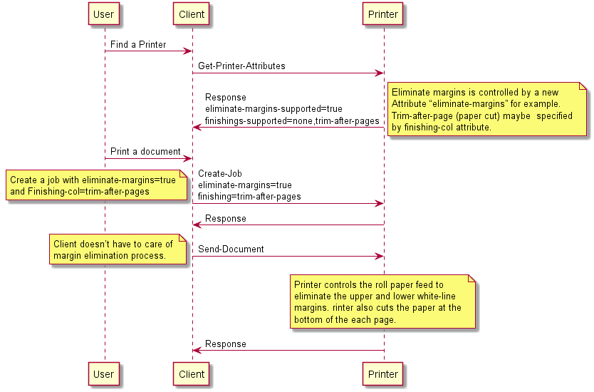
Expected new IPP attribute (example)

