Slide 1
The flap position of “You” envelopes is fixedly treated
The flap position of “You” envelopes is fixedly treated on long-edge currently, even though there is no formal specification, and variations exist in practice. So this is not always the case.
For example, a product called “You 4 Tate(meaning Vertical)” is also available on the Japanese market.
Therefore, cases where the flap is on the short edge of the envelope should also be considered. 2nd Proposal is considered more natural and consistent with the ISO-C naming rule.
1st Proposal
If the flap is on the short-edge: jpn_you4-short-edge_105x235mm → You 4 Tate(Vertical)
If the flap is on the long-edge: jpn_you4_235x105mm
2nd Proposal
If the flap is on the short-edge: jpn_you4-105x235mm → You 4 Tate(Vertical)
If the flap is on the long-edge: jpn_you4-long-edge_235x105mm
You 4 Tate(Vertical)
-Width=105mm
-Height=235mm

Slide 2
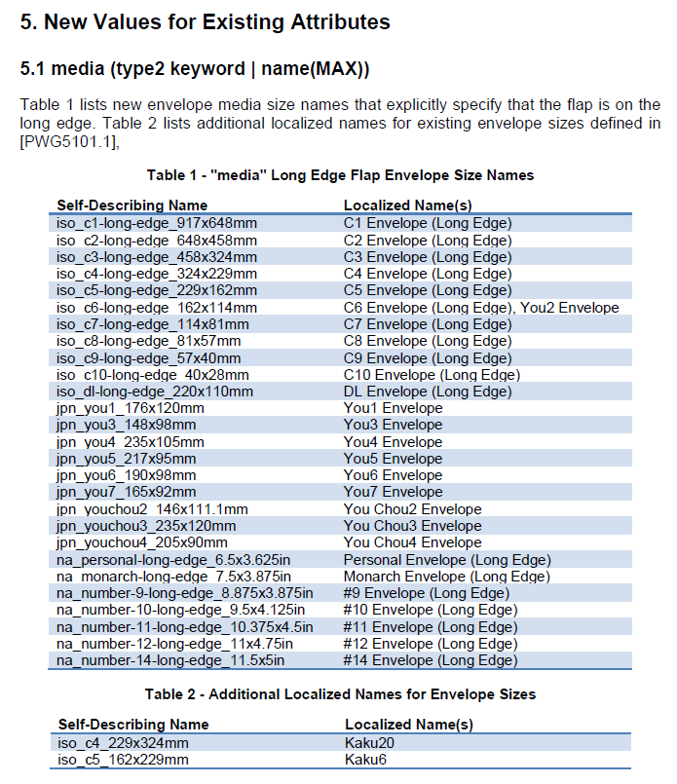
The flap position of “You Chou” envelopes is fixedly treated
If 2nd Proposal (page 3) for handling the flap position of “You” envelopes is adopted, it would be better to align the naming accordingly to be able to handle the flap on the short edge.
jpn_chou2-long-edge_148x111.1mm
jpn_chou3-long-edge_235x120mm
jpn_chou4-long-edge_205x90mm
IANA registered name
jpn_chou3_120x235mm
IANA newly registered name
jpn_youchou3_235x120mm
Please note that “Chou3 Envelope(Long Edge)” would be the same size and flap position as “YouChou3 Envelope”

Slide 3
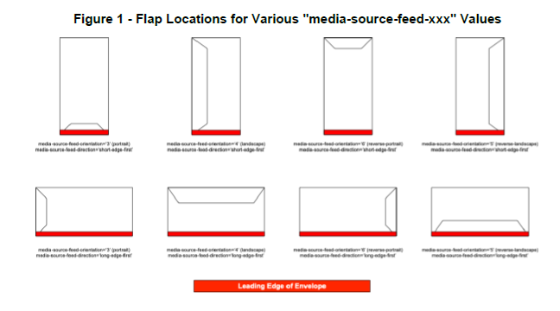
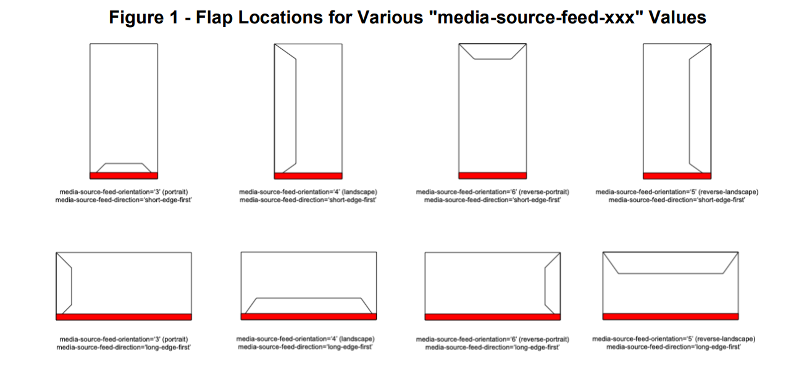
The orientation for some of envelopes are incorrect
The 2nd and 4th image with red rectangles on the bottom row needs to be fixed.
Expected fixes shown below.
Which is the front side and back side having the flap of the envelope in Figure 1, when fed to input-tray? (We assume that the face-down fed printer is used for this figures.)
Observed:
Expected:

Slide 4
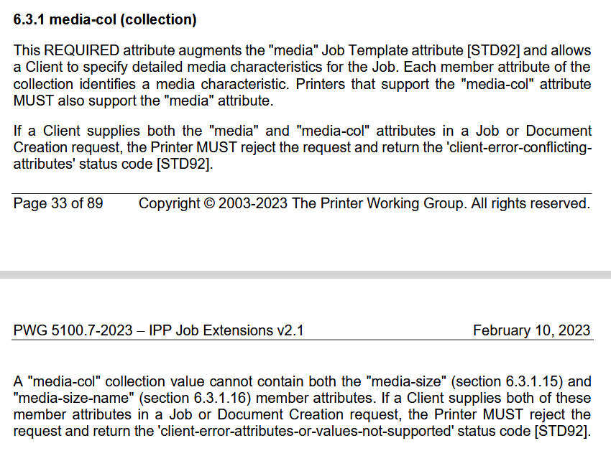
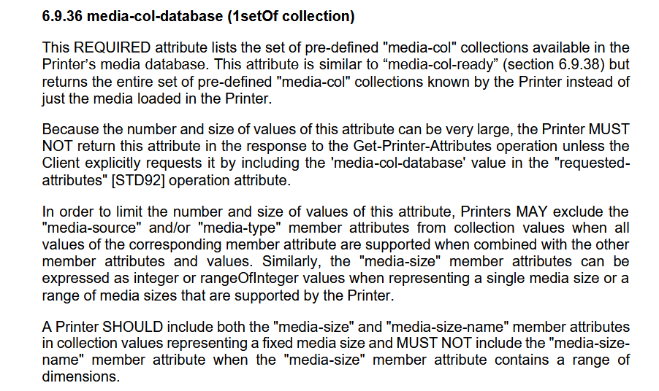
Constraints on media-size-name member attribute in media-col
Within the media-col attribute, the media-size and media-size-name member attributes are intended to be used exclusively of each other.
Since media-size and media-size-name are mutually exclusive within media-col, it is assumed that clients will not specify media-size-name.
It is explicitly stated in IPP Envelope Media Extension 1.0 that when the envelope flap is on the long edge, the media-size member attribute in media-col should be expressed with X > Y.
Why adding new rules for “you” prefix and “-long-edge” suffix necessary on media-size-name?
Isn’t adding Localized Names for long edge envelope size good enough for original purpose?
IPP Job Extensions v2.1
IPP Job Extensions v2.1

